Slide 1
MoIRE ALGORITHM PRESENTATION

Slide 2
AGENDA
Moire Algorithm
Shape Construction
Problems
Final Pipeline
User interface Demo

Slide 3
At the beginning:
We needed a strait forward algorithm for taking an input file – the clock graphics and producing a revealer grid and base grid.
Requirements:
No specific manufacturing methods known yet
Revealer and base should create a clear and readable clock

Slide 4
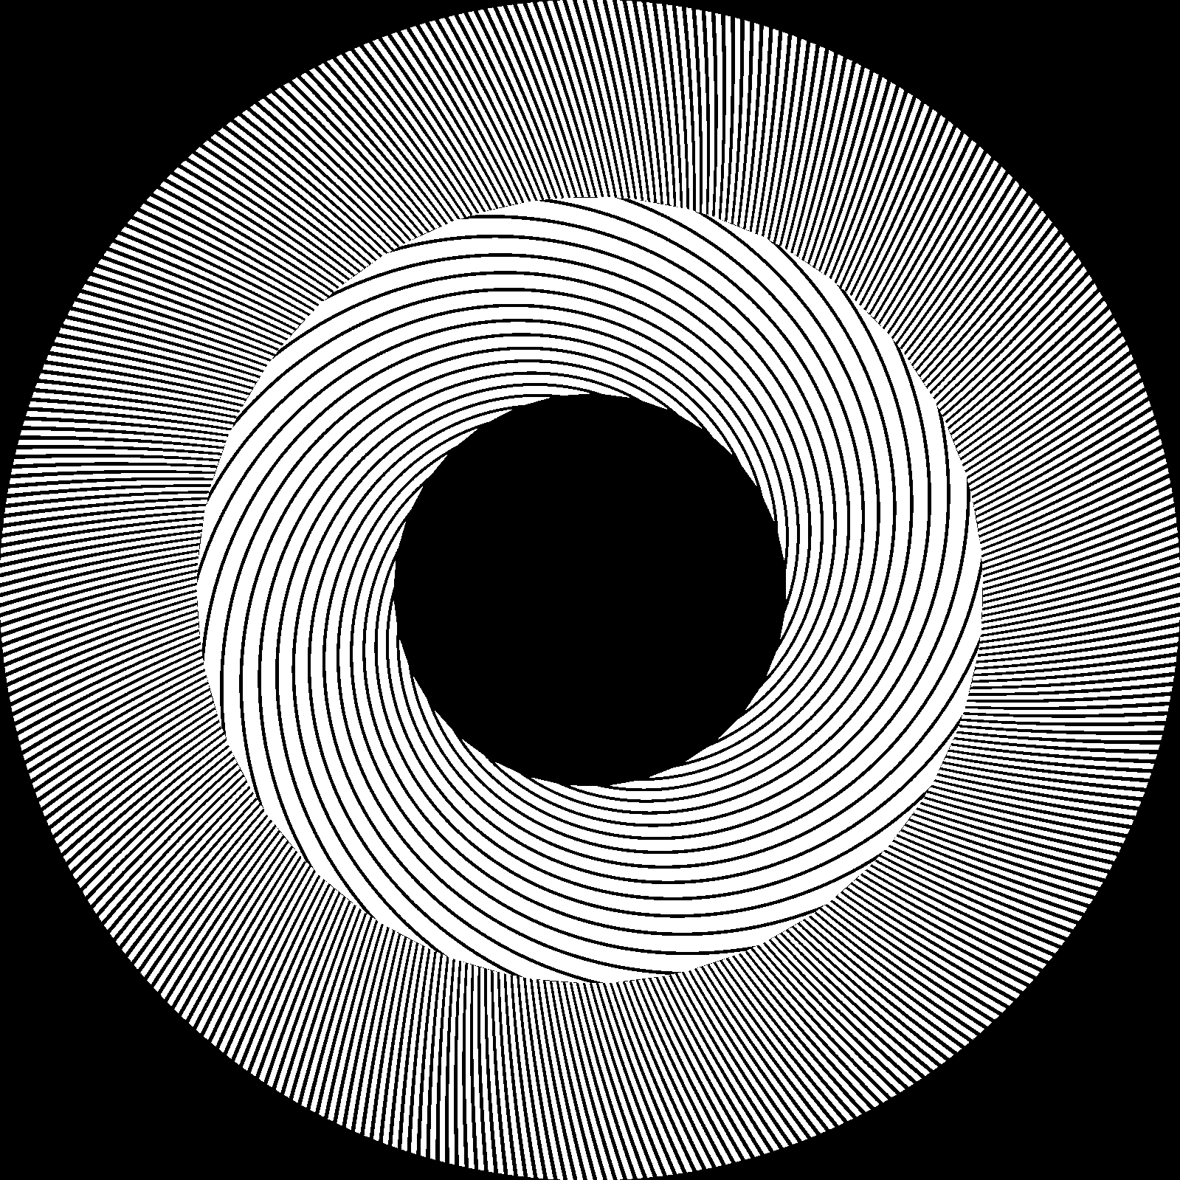
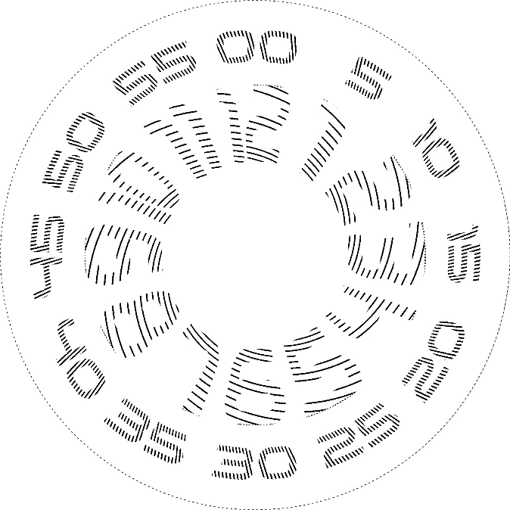
Results First Iteration
Simple solution:
Raster Image
One hour ring One minute ring minute ring is 12 times the speed of the hour ring in order to create the required effect of a tunes clock. Controlable width for visuals Boolean mask shape finding.

Slide 5
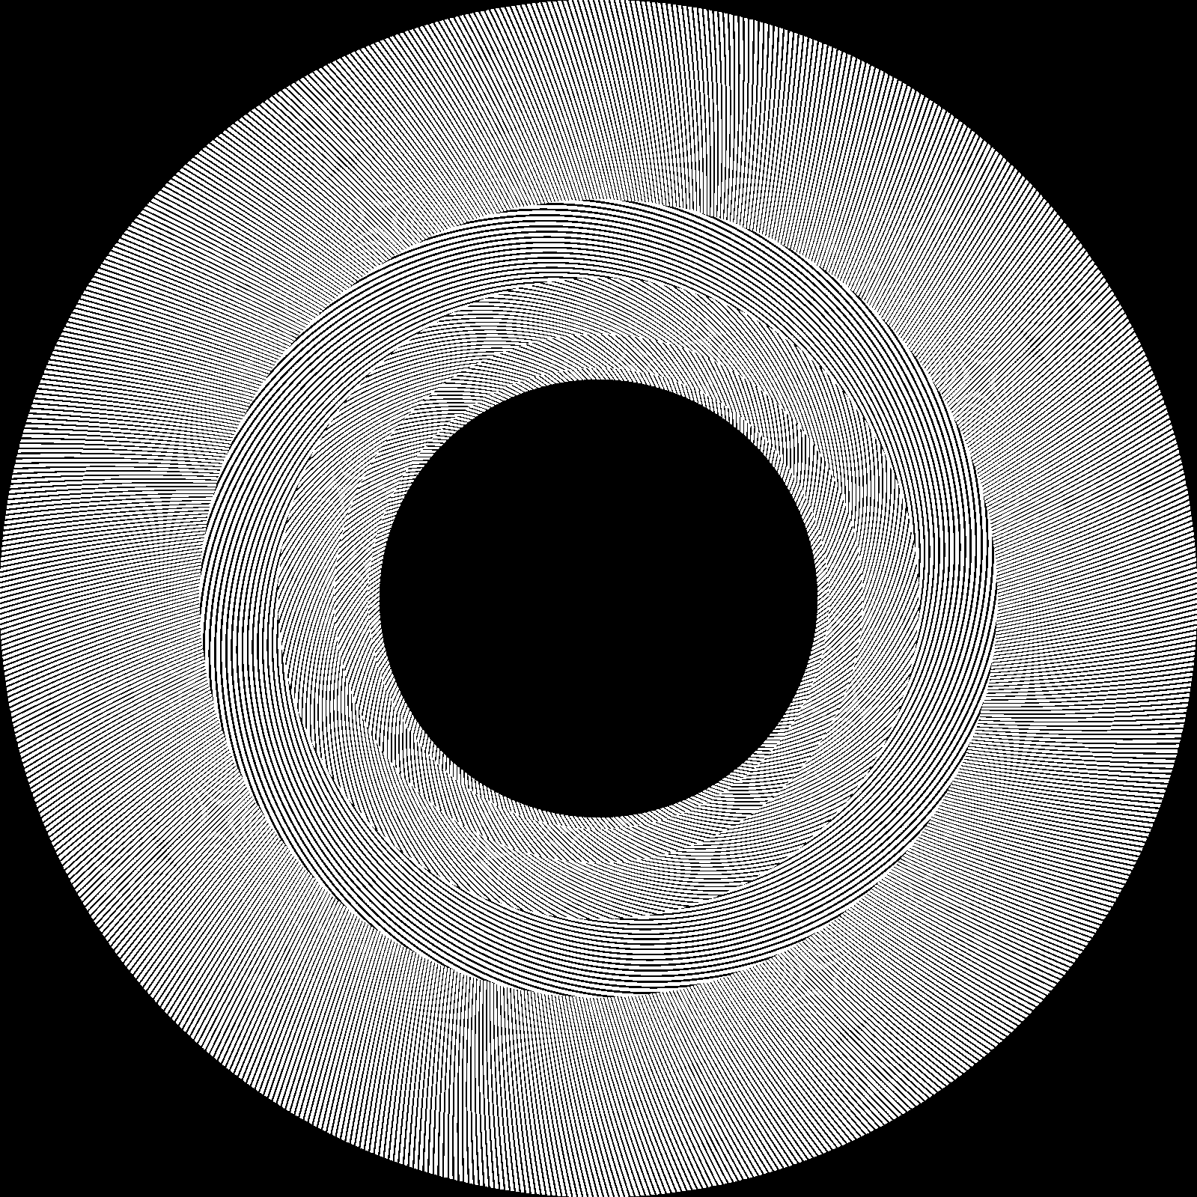
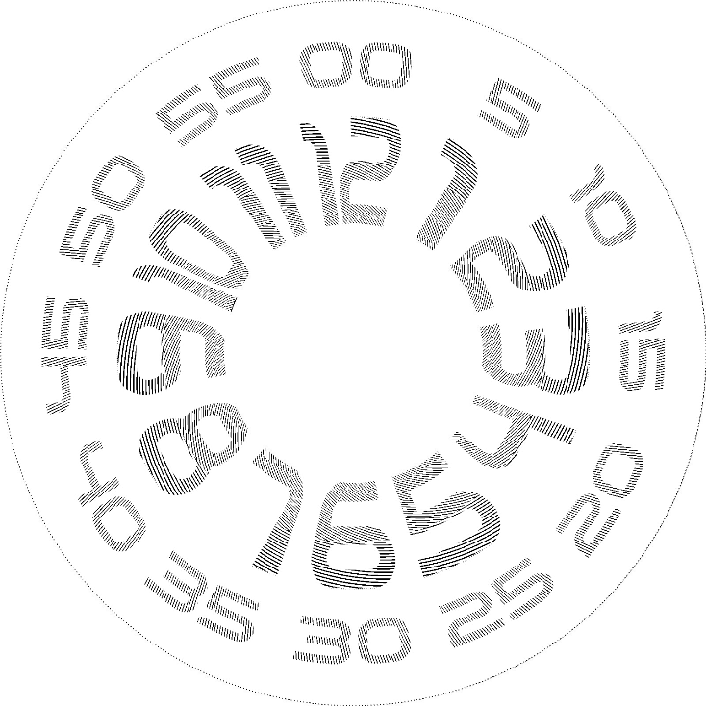
Results Second Iteration
Multiple hour ring One minute ring we created multiple rings in the hour region to create a more focus moire effect across the intended number. This technique comes at a cost we will see next

Slide 6
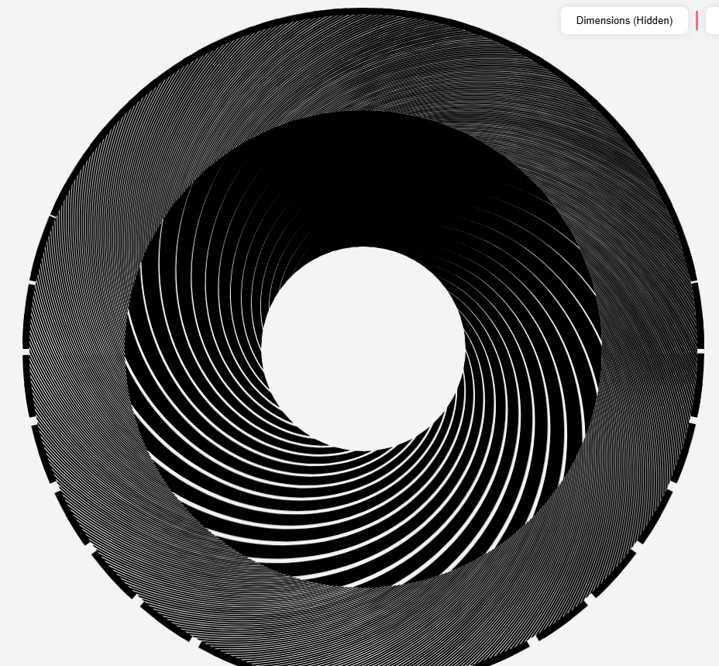
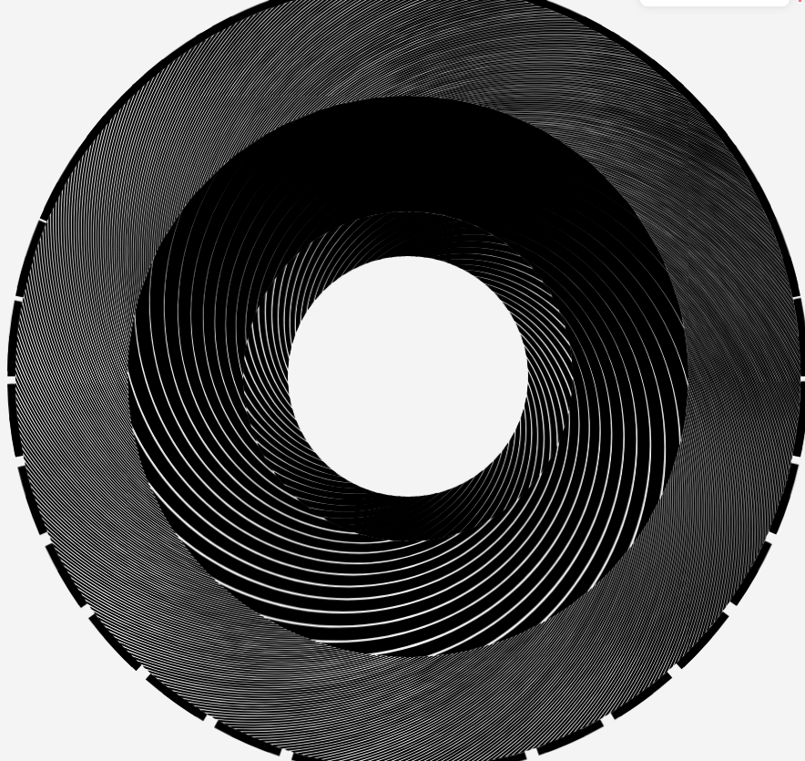
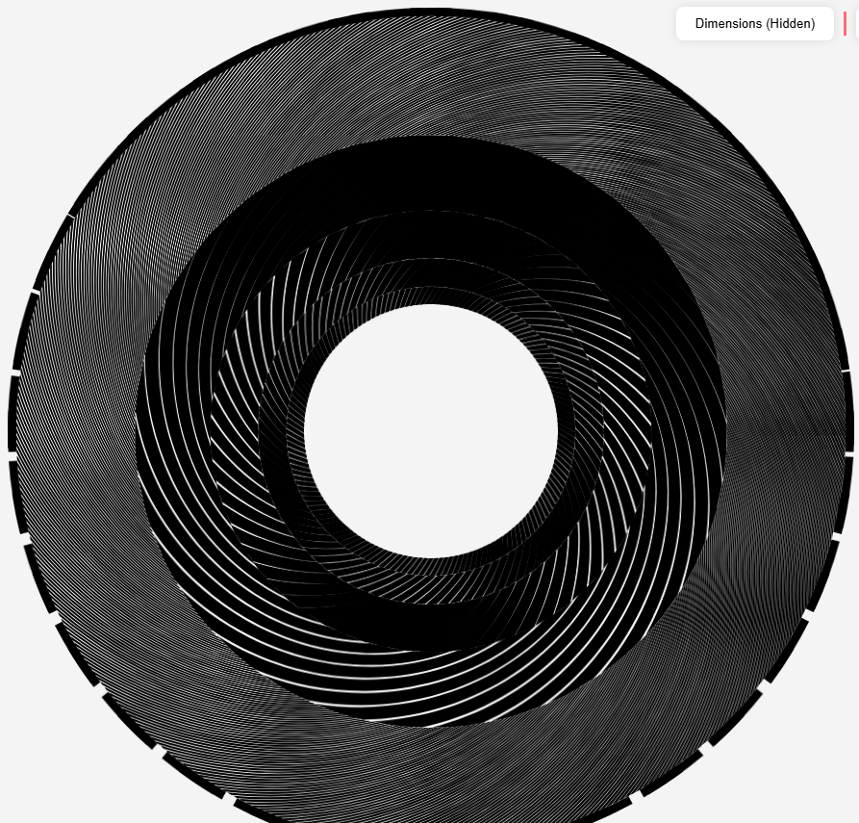
1 ring
2 ring
4 ring
Moire repetitions: [1]
Moire repetitions: [1,2]
Moire repetitions: [1,2,3,5]
We use prime numbers so artifacts don’t group

Slide 7
Next sprint:
Production will be in vector format – implications:
New shape recognition and construction algorithms are needed
The new format allows for easy protability to web and a new UI/UX is designed

Slide 8
Collision and shape recoginision:
The new vectorized format doesn’t allow for Boolean masks to work
A collision detection and logic are to be implemented
We use convex hull properties to filter out more probable collision and non probable collisions
We use in the modified algorithm techniques to find optimal bounding boxes in order to increase the number of lines filtered out
We use segments of the full line in order to check more locally and faster

Slide 9
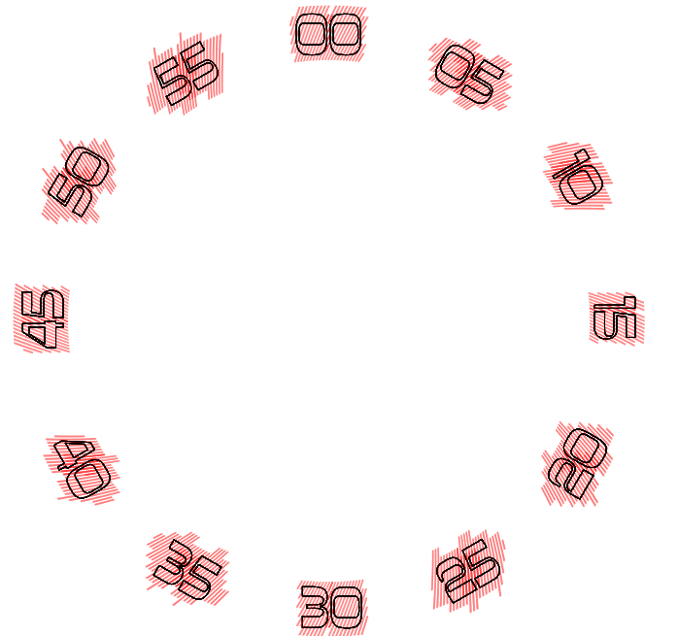
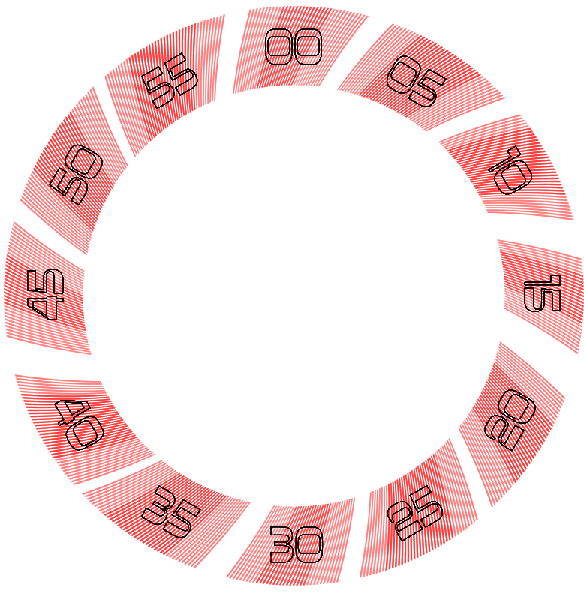
Collision and shape recognition:
Very costly at high resolution! Only used for the precise cutting template. Before you is a comparison of the old algorithm and its modified version:
Old algo!
Elapsed Time: [68.30s, 179.11s, 13.69s, 11.63s, 10.80s, 17.32s] , Total: 300.87s
new algo!
Elapsed Time: [33.83s, 33.94s, 15.93s, 10.27s, 6.09s, 0.74s] , Total: 100.82s
lines checked: old vs new (#line)
lines checked: 689 vs 425 (540)
lines checked: 482 vs 252 (45)
lines checked: 181 vs 163 (90)
lines checked: 221 vs 207 (135)
lines checked: 241 vs 152 (225)
lines checked: 99 vs 0 (45)

Slide 10
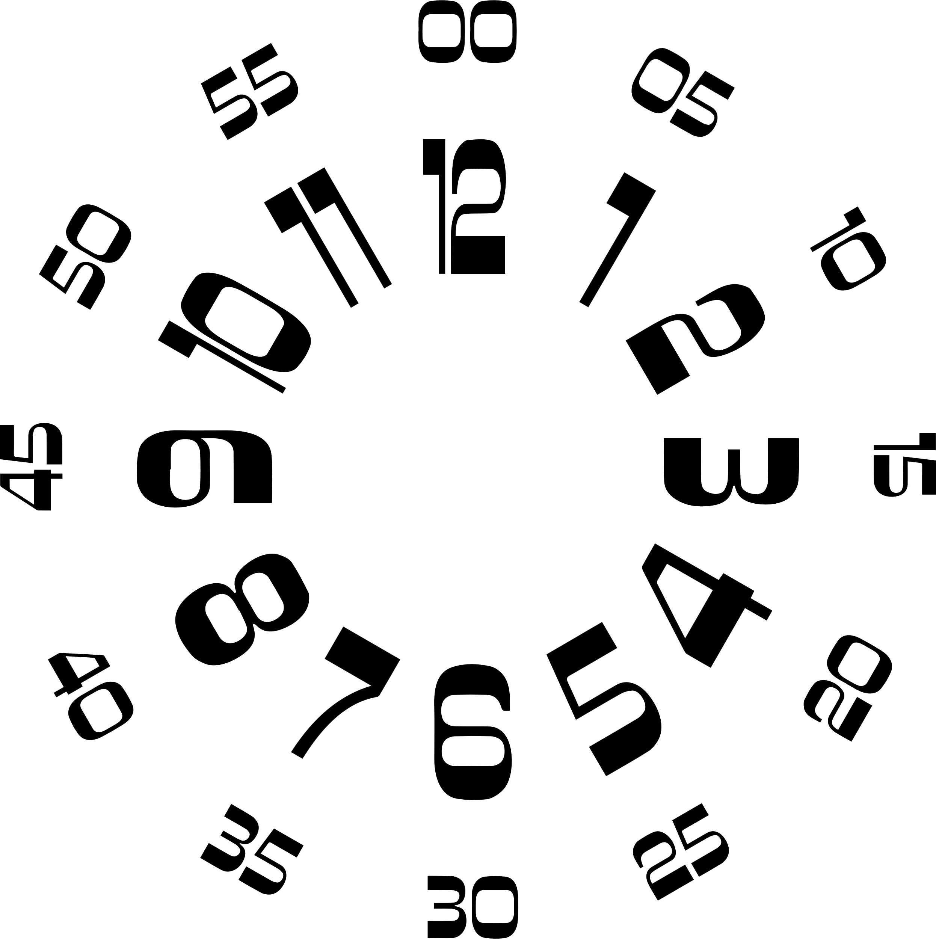
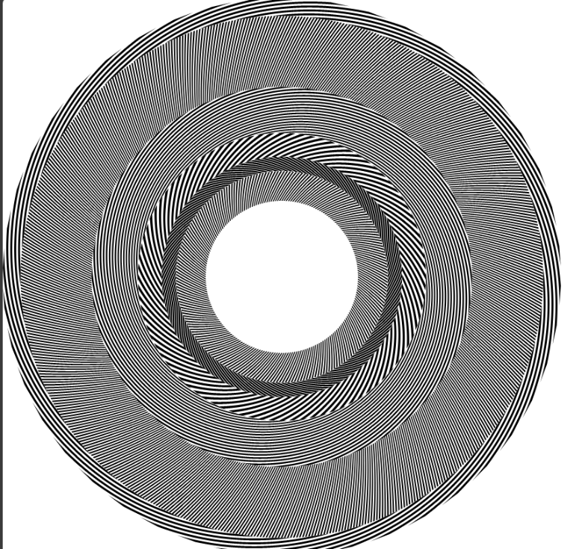
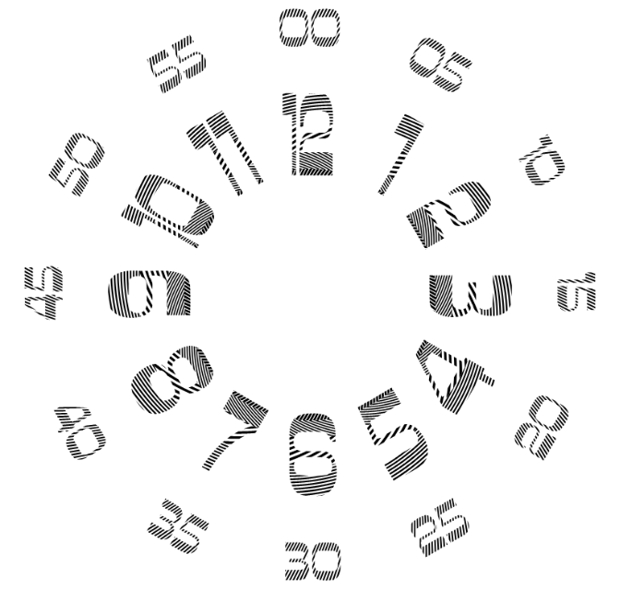
Results:

Slide 11
Is this enough?
No, while for the cutting process this is the end but for a responsive UI the size of the file of high res curved polygonal shapes is immense

Slide 12
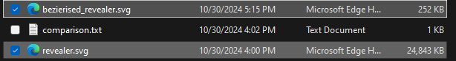
Effective Method of reducing size and INcreasing additive-grid (Revealer) construction for Site use:
Interpolation into B-splines → converting to cubic Bezier curves supported by Svg file format → reducing a 1000 points into sometimes..4.. 8.
Smaller files for the server to return = faster site response!
Very effective for our need for rotate – copy – paste .. N times

Slide 13
Demo

Slide 14
Input ring data
For site
For production
Input image
Additive grid
Cutting Grid
Additive grid
Curve calculation
Interpolation into b-spline
Modified collision algo
Split into sub segments
Find optimal bounding box using graham-scan and rotating-calipers algo
Apply rotation copy and paste
Separate to Bezier curves
Check for collision range
Apply rotation copy and paste
Check for fine collisions and build shape

Slide 15
Thank You keren, noam and Shachar

